Slide 1
Cellular respiration
By: Liane, Heavenly, Savanna

Slide 2
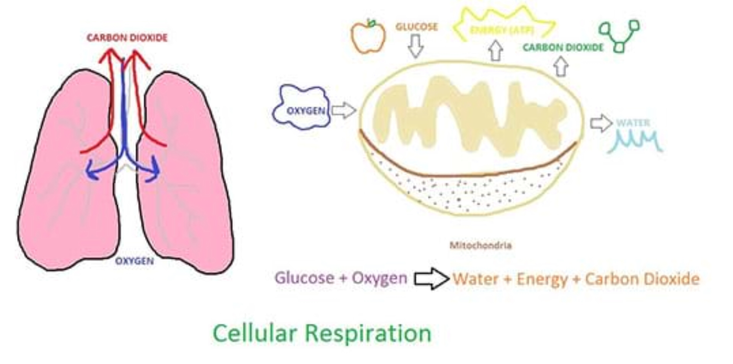
What is cellular respiration?
Cellular respiration is the process by which organisms combine oxygen with food stuff molecules, diverting the chemical energy.

Slide 3
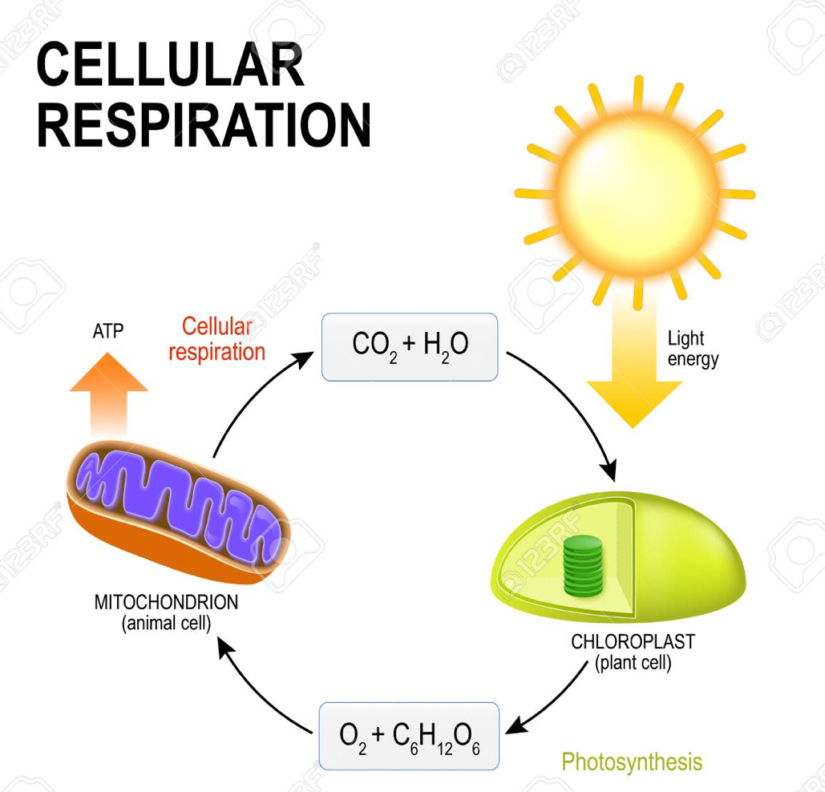
How does cellular respiration work?
The oxidizing of foodstuff molecules that is converted to energy, that is then released to create ATP for use by the activities that consume energy. The two phases in which the process occurs are glycolysis, the breakdown of glucose to pyruvic acid.
The equation for cellular respiration is: C6H12O6+6O2> 6CO+6H2O

Slide 4
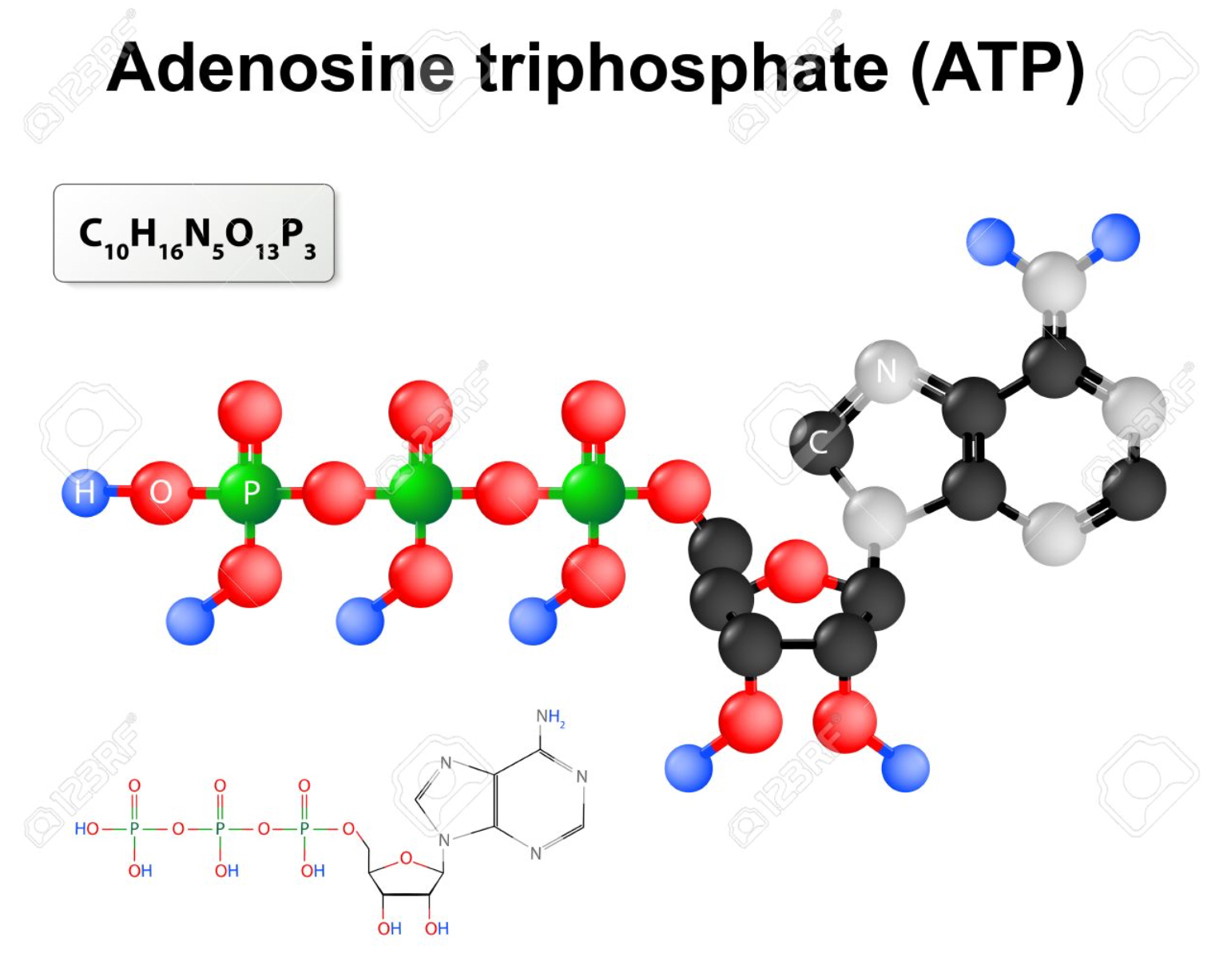
What is ATP?
ATP (adenosine triphosphate)
ATP is a energy molecules found in every cell. It’s job is to store and supply the cell with needed energy.

Slide 5
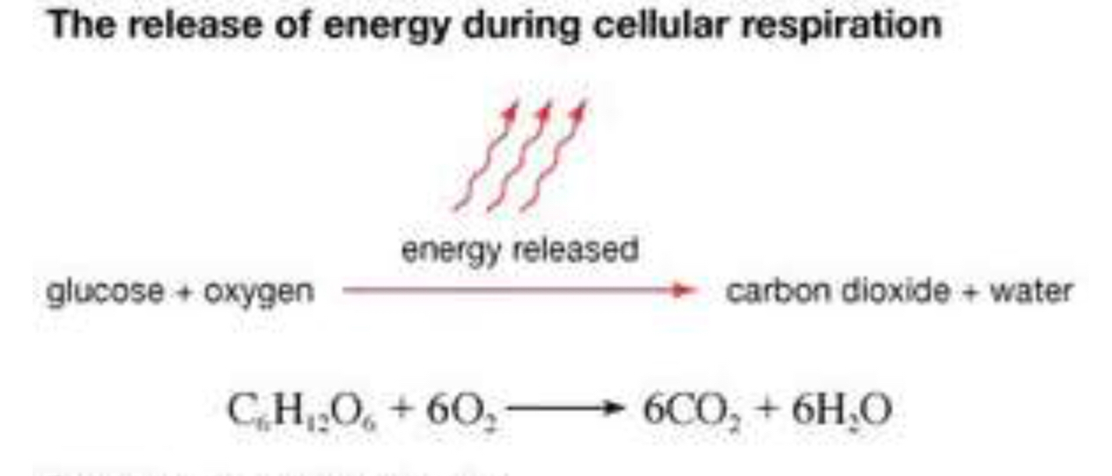
What is food stuff molecules?
Food stuff molecules is like carbohydrates, fats, protein, alcohol.

Slide 6
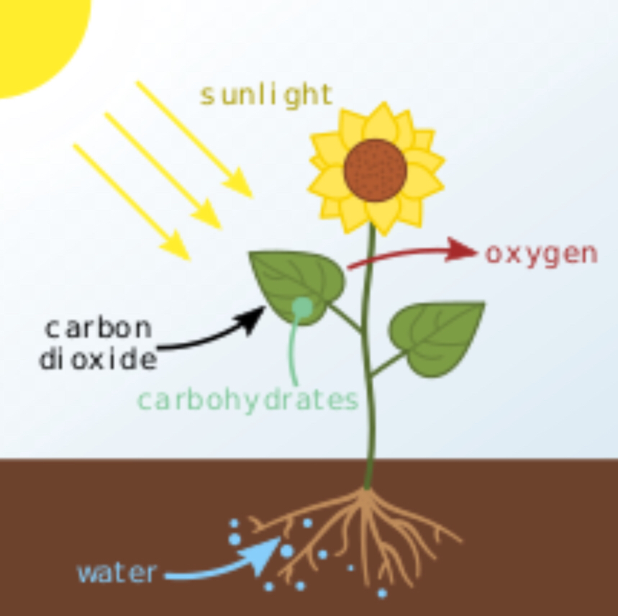
When does photosynthesis happen in the carbon cycle?
Photosynthesis happens when carbon dioxide is released into the atmosphere.
However cellular respiration happens when carbon dioxide is released into the atmosphere

