Slide 1
P- and S-Waves
By Mrs. Smith

Slide 2
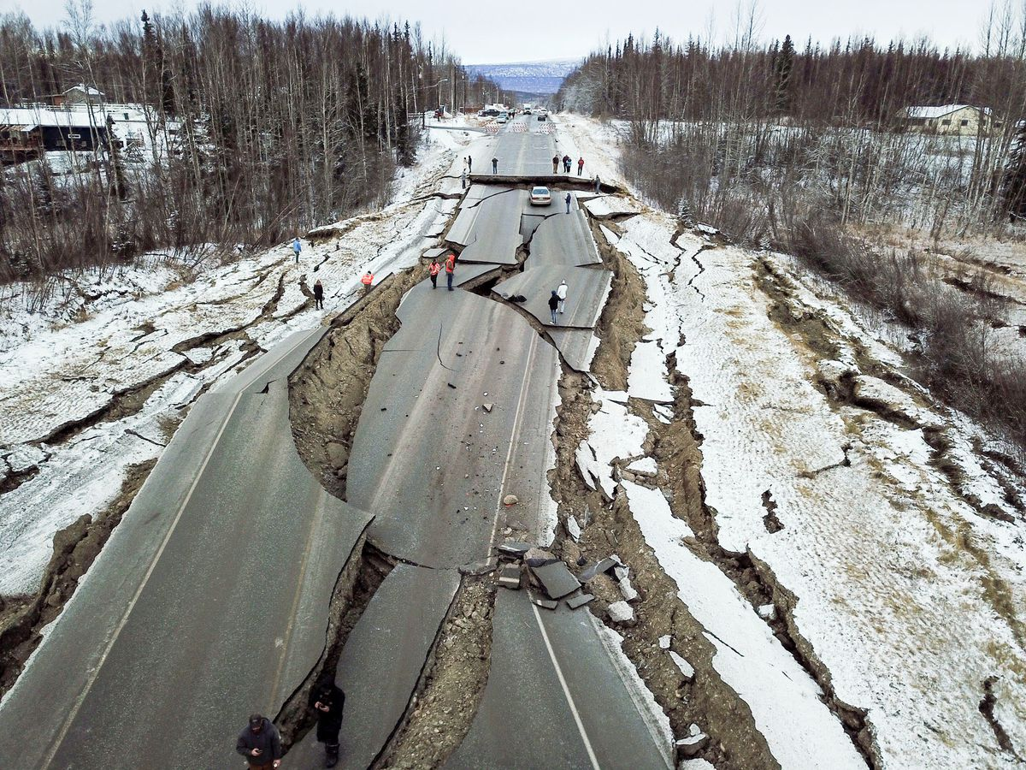
How can you measure the body waves from last month’s Earthquake here in Utah?
Go to the new phenomenon page on our class website and fill out the Initial Answer form.

Slide 3
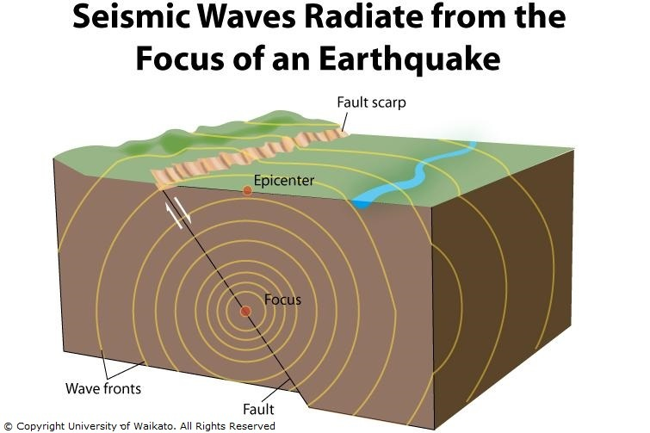
SEISMIC waves
SEISMIC WAVES are waves of energy caused by the sudden breaking of rock within the earth, movement of a fault, or an explosion. These waves carry the energy from the Focus or Hypocenter through the earth.

Slide 4
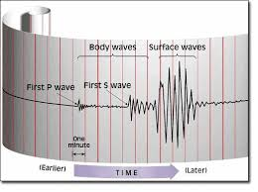
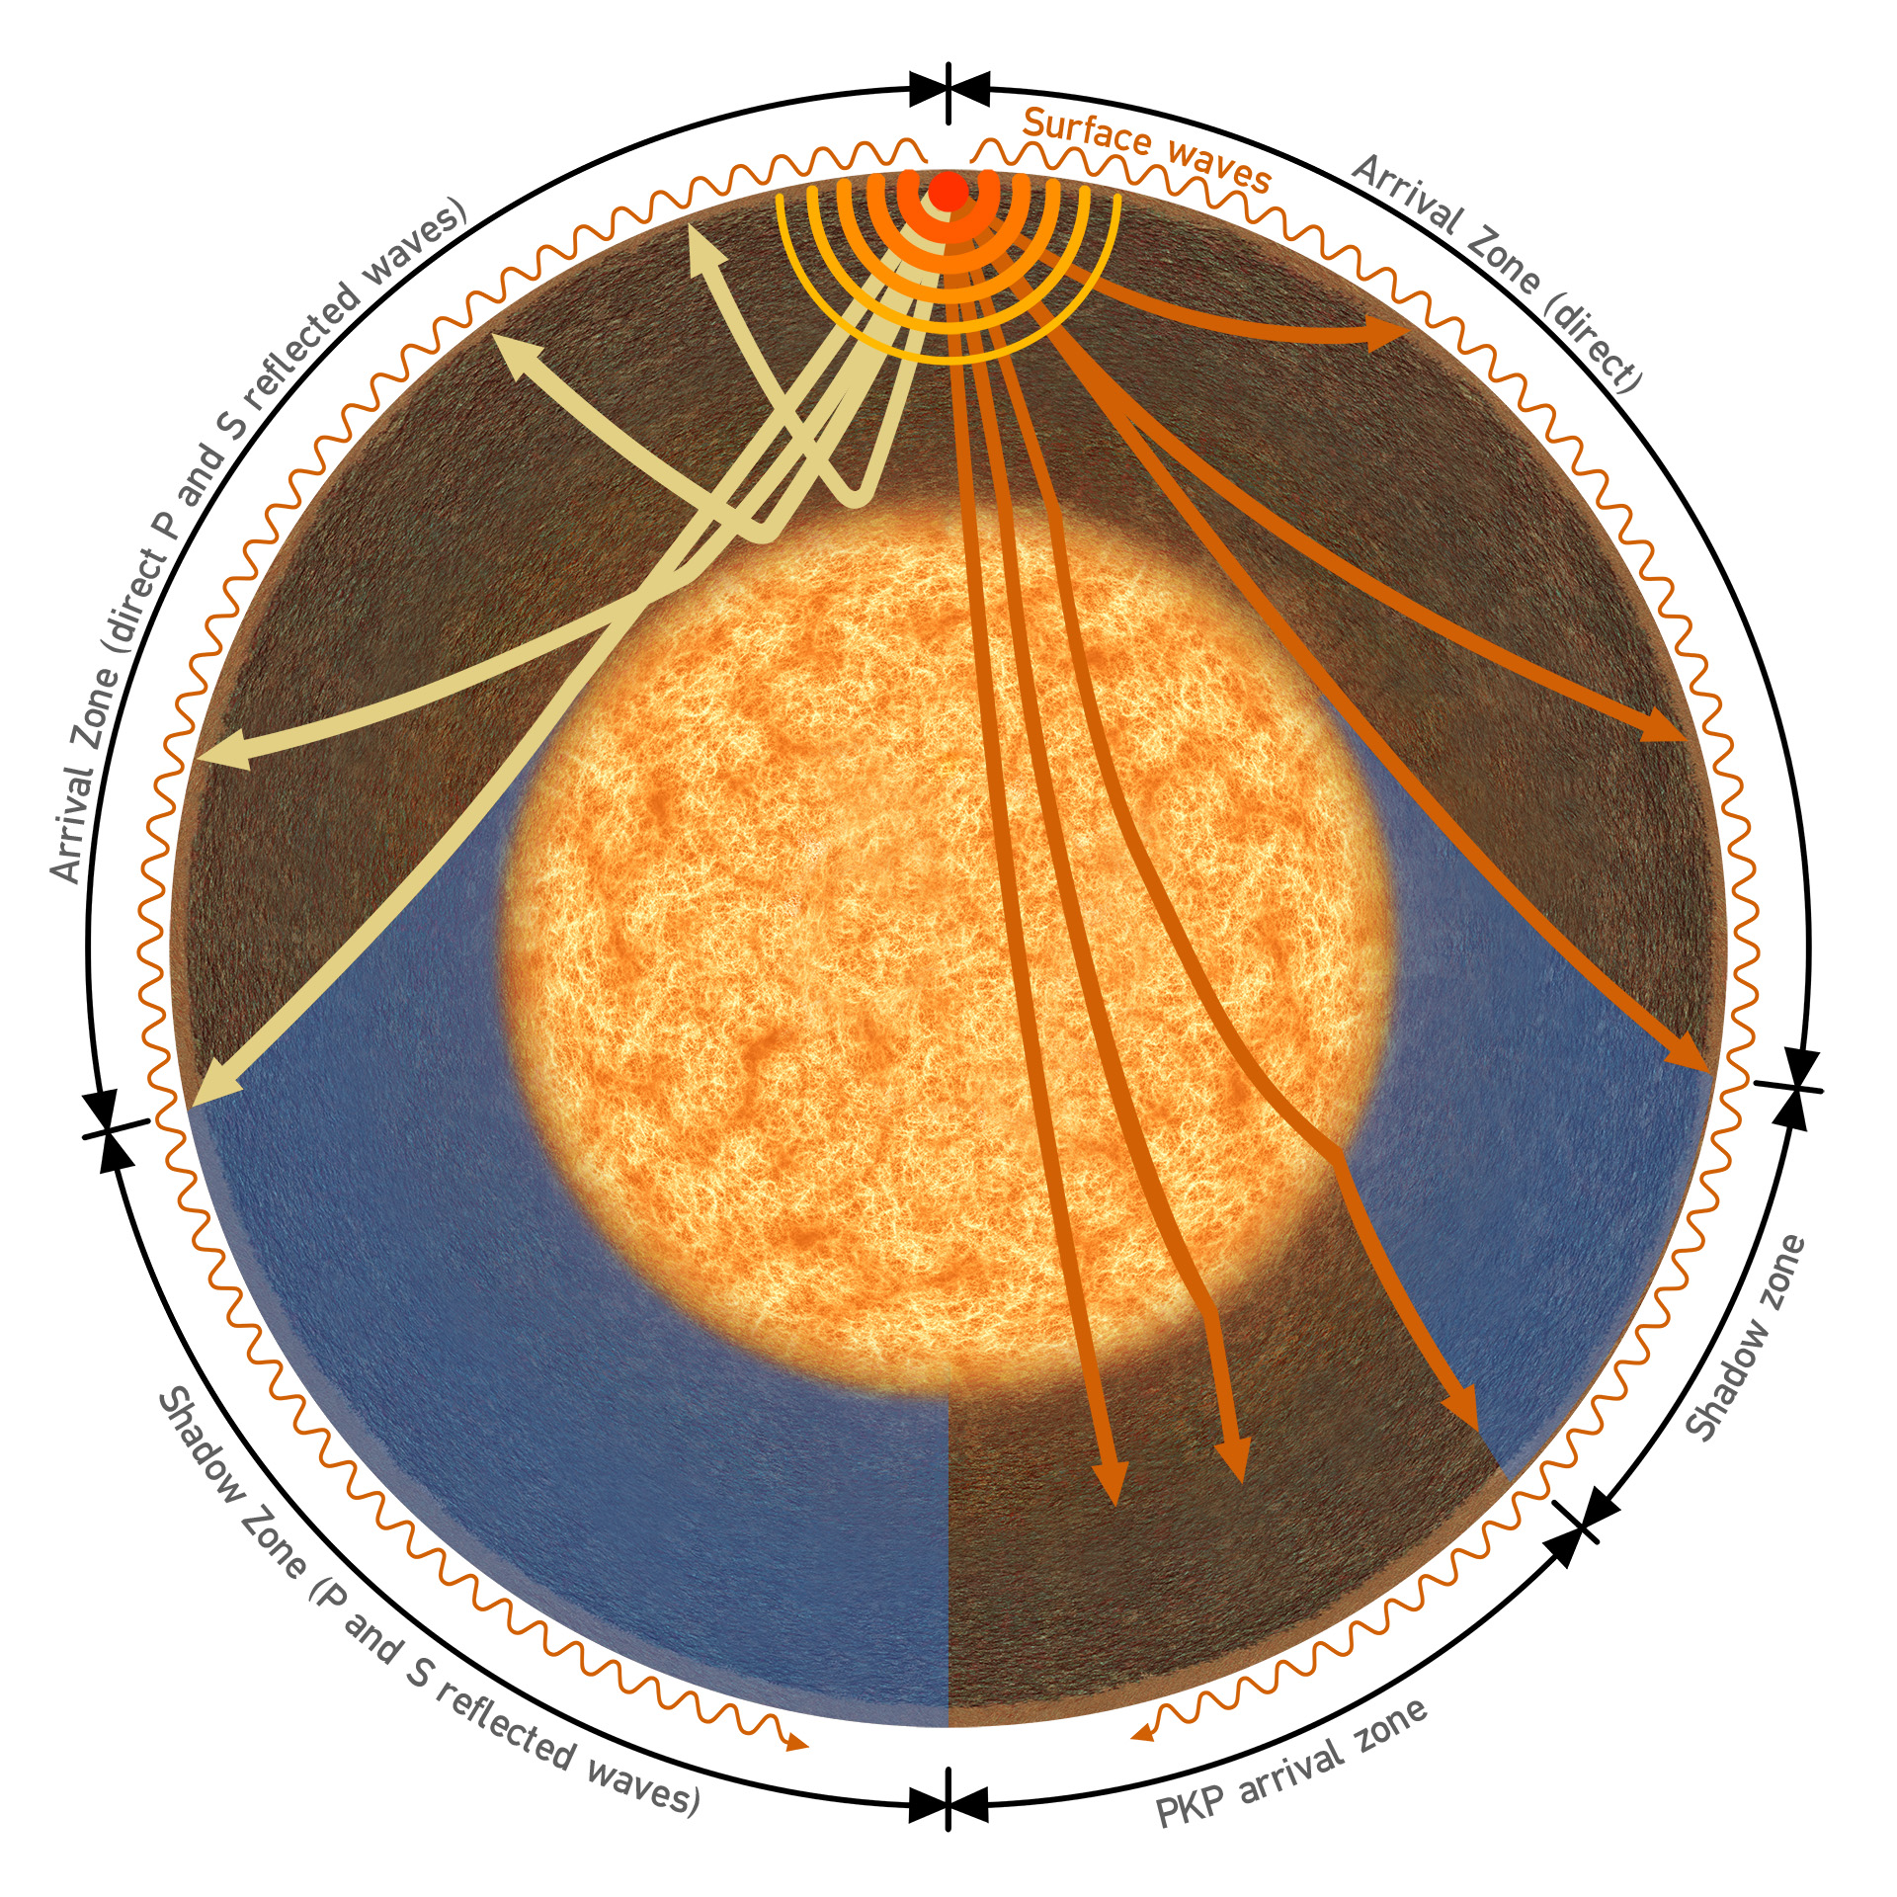
Seismic waves
Seismic waves are recorded on a Seismograph. The seismograph measures: The time at which the earthquake occurred. The epicenter, which is the location on the surface of the earth below which the earthquake occurred. The depth below the earth's surface at which the earthquake occurred.

Slide 5
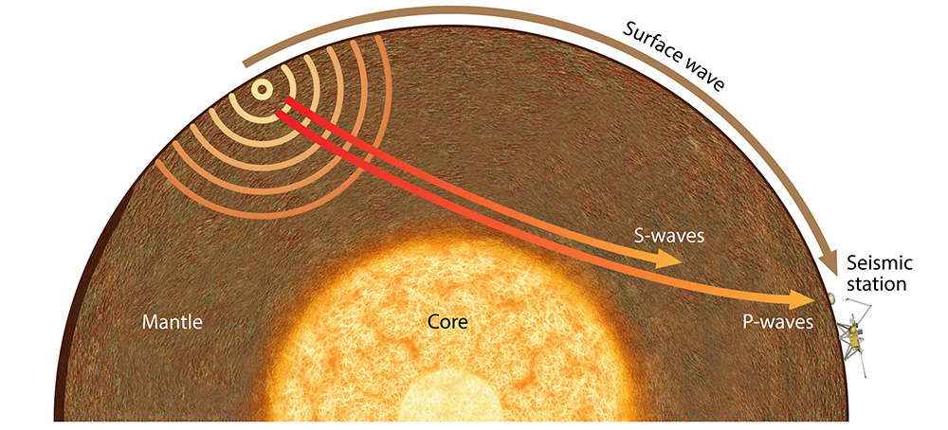
Body waves vs surface waves
There are two major types of Seismic Waves: BODY WAVES and SURFACE WAVES
BODY WAVES (P- and S-Waves) travel through the earth’s inner layers (Mantle and Outer Core). These waves arrive first because as the wave moves deeper into the earth they have a tendency to move faster due to increased pressure and density as you get closer to the core of the earth.

Slide 6
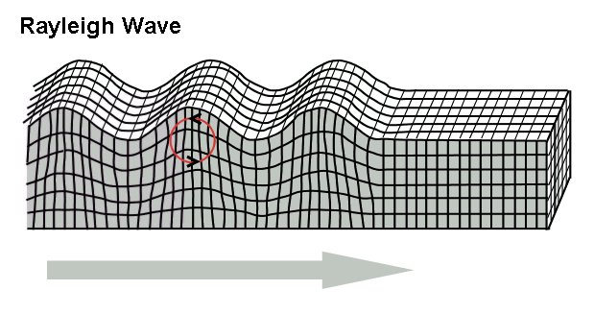
Body waves vs surface waves
SURFACE WAVES travel on the surface of the crust, just like ripples in a pond of water. Surface waves comes in 2 types:
Love Waves – are surface waves with a rolling motion. Love Waves are transverse waves.
Rayleigh Waves – are waves that have a rolling motion, like an elliptical motion.
Love Wave

Slide 7
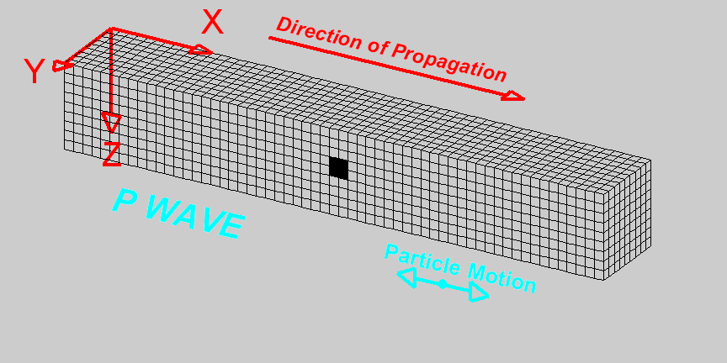
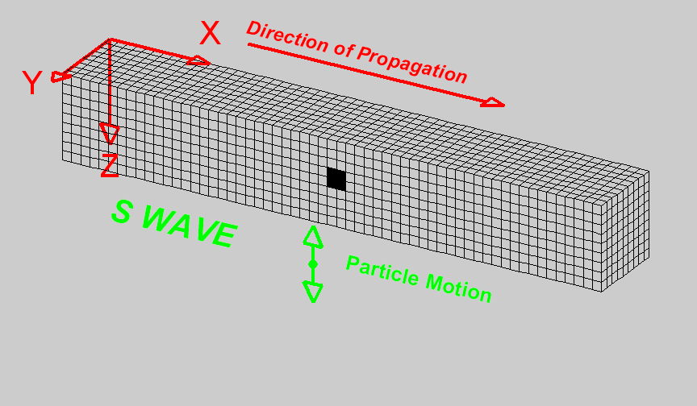
Body waves vs surface waves
BODY WAVES come in two types of waves:
P- Waves (primary waves) which are compressional waves.
P-Waves move in the same direction that the wave is moving in, which is the direction in which the energy is traveling.
P-Waves are the first wave, the fastest wave in an earthquake. P-Waves can move through all layers of the earth, including the liquid core
P-Waves give us a small jolt, light shaking, or sometimes no movement
S-Waves (secondary waves) which are sheer/transverse waves.
S-Waves move rock particles up and down or side to side, perpendicular to the direction that the wave is traveling
S-Waves are the second waves that you feel in an earthquake. S-Waves can only travel through solid layers of the earth
S-Waves give us the larger jolt, or stronger shaking that comes with an earthquake

Slide 8
Body waves
When an earthquake occurs the P- and S- waves spread out in all directions through the Earth's interior.
Seismic stations located at increasing distances from the earthquake epicenter will record P- and S- waves that have traveled through increasing depths in the Earth.

Slide 9
Watch for the P- and S-Waves

