Slide 1
P- and S- Wave Graphs
By Mrs. Smith

Slide 2
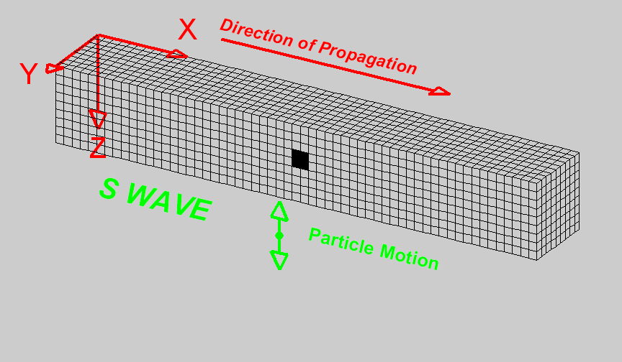
P-Waves and S-Waves
Notes:
Who can write in the Chat what a P-Wave is
Who can write in the chat what a S-Wave is

Slide 3
P-Waves and S-Waves

Slide 4
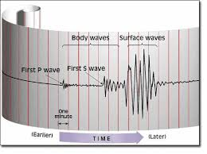
P-Waves and S-Waves

Slide 5
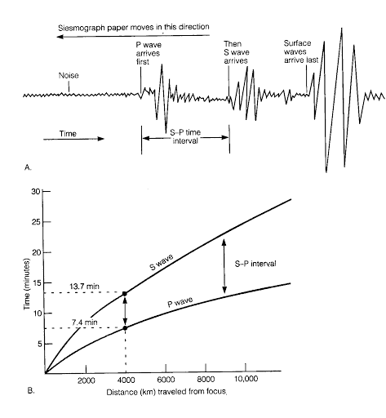
P-Waves and S-Waves

Slide 6
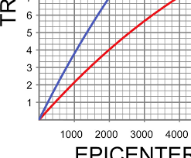
P-Waves and S-Waves: Graphed

Slide 7
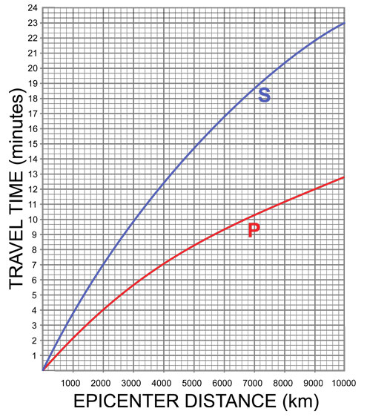
P-Waves and S-Waves: Finding Interval Times and Distance from Epicenter

Slide 8
P-Waves and S-Waves: Finding Interval Times and Distance from Epicenter
In 10 minutes, how far had the S-Wave traveled?

Slide 9
P-Waves and S-Waves: Finding Interval Times and Distance from Epicenter
How long did it take
the S-Wave to travel
5000 km?

Slide 10
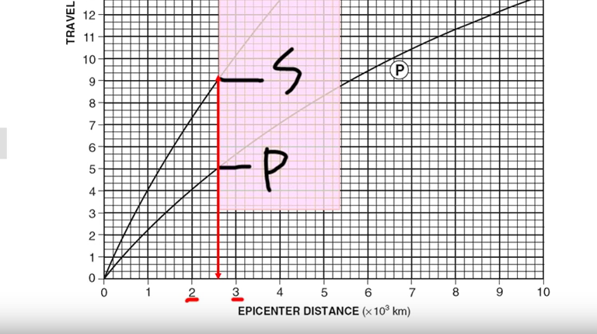
P-Waves and S-Waves: Finding Interval Times and Distance from Epicenter

Slide 11
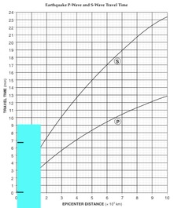
P-Waves and S-Waves: Finding Interval Times and Distance from Epicenter
What information to collect:
What exact time did the P-Wave hit?
What exact time did the S-Wave hit?
What is the difference between these two times? This is the
S-P Time Interval or Lag Time
Example:
The S-Wave hit at 3:06:40 a.m
The P-Wave hit at 3:00:00 a.m.
S time – P time
= S-P Interval/Lag Time = 6:40
The distance is 2600 km
What to do: 1. Take paper and mark at 0:00 and at the S-P Time Interval/Lag Time on the edge of the paper
2. Take paper and slide it along the S- and P-Wave Lines until the lines touch the curves.
3. Draw a line straight down to the distance on the x-axis – this will tell us the distance the seismic station was from the epicenter

Slide 12
P-Waves and S-Waves: Finding Interval Times and Distance from Epicenter

Slide 13
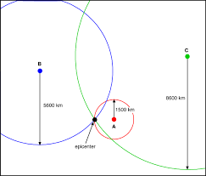
P-Waves and S-Waves: Finding Interval Times and Distance from Epicenter

