Slide 1
Sound Waves - Review
By Mrs. Smith

Slide 2
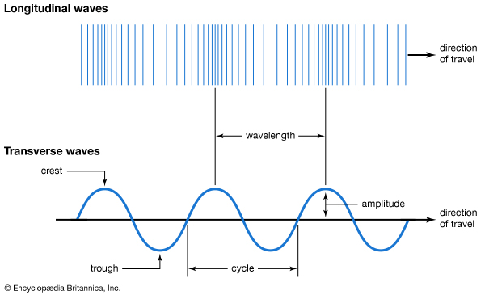
Sound is a Compressional/Longitudinal wave
Notes:
Can you give examples of compressional waves in real life?
What is traveling through the waves?

Slide 3
Sound Waves are Mechanical Waves
Sound is a mechanical wave is an oscillation of matter or in other words, sound needs a medium to travel through
Notes:
What type of matter is the sound moving through in the Ruben’s tube?

Slide 4
Sound needs a medium to travel though
What is initiating or starting the sound?
Notes:
What type of matter or medium is sound traveling through in this example?

Slide 5
Sound travels at different speeds through different medium
Notes:
What causes sound to travel through different mediums at different speeds?

Slide 6
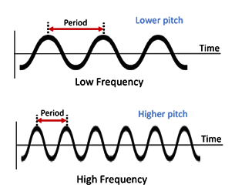
Sound Waves have Pitch
Frequency determines Pitch
Notes:
Explain Pitch in your own words…

Slide 7
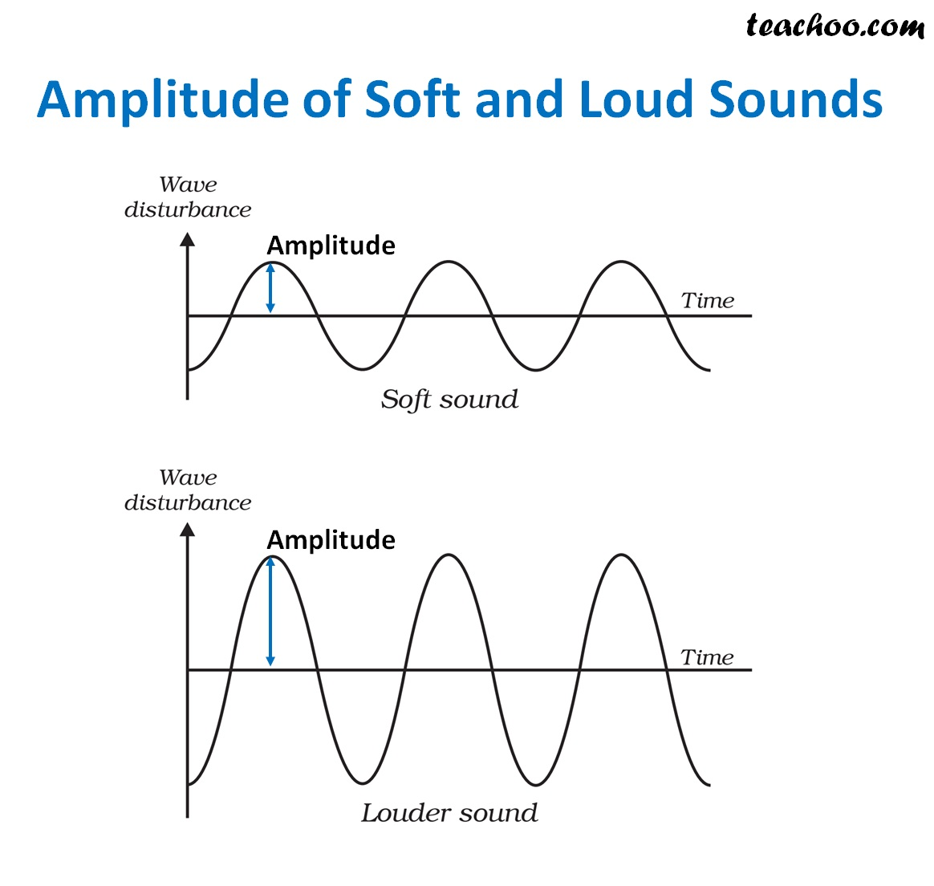
Sound Waves a have Loudness Factor
Amplitude determines how loud a sound is
Notes:
How is loudness depicted in a wave?

Slide 8
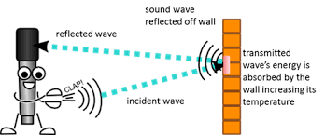
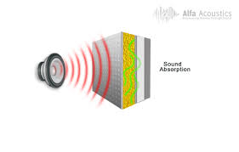
Sound can be reflected and absorbed
https://youtu.be/uU5gqrBwo6o
Examples of reflection and absorption of sound in real life situations https://www.youtube.com/watch?v=a3KFmOHvs2E
Notes:
Explain how reflection of sound works.
Explain how absorption of sound works.

